Slide 1
Endorsements Professional Development Event for Education Students 11/2/17
Dr. Melissa Luis
Middlesex County College
Ms. Cecilia Zimmer
Supervisor of ESL/Bilingual & World Language
Freehold Borough Schools
Dr. John Crowe
Principal
Woodbridge Middle School
Dr. Joseph Harvey
Director of Special Services
New Providence School District

Slide 2
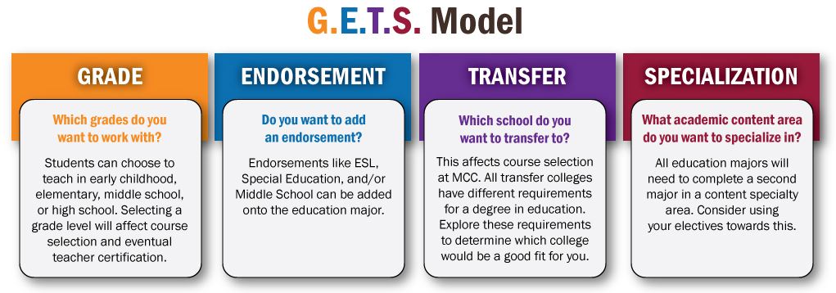
Let’s Starts with our G.E.T.S. Model

Slide 3
What are Endorsements?
Expand your certification areas
Academic areas that are added onto the grade level
Grade Level: P-3, K-6,
K (p)-12

Slide 4
Examples of Endorsements:
Special Education
Bilingual
ESL
Middle School

Slide 5
Examples of Certifications with Endorsements
K-6
Middle School (5-8)
K-6
Special Education
K-12
ESL

Slide 6
English as Second Language
and
Bilingual/Bicultural Endorsements
Cecilia Zimmer
Supervisor of ESL/Bilingual
Freehold Borough School District
czimmer@freeholdboro.k12.nj.us

Slide 7
The NEED for ESL/Bilingual Teachers
NJ communities are growing culturally and linguistically. This change makes for vibrant and diverse communities. The 2014 census data showed that 30% people older than four spoke a language other than English at home (U.S. Census Bureau, 2009-2013). As a result, the English language learner (ELL) population in NJ has grown significantly.
The New Jersey Bilingual Code, N.J.A.C.6A:15, outlines rules and regulations for bilingual, ESL, and ELS programs in the state of NJ.
NJ reported a SHORTAGE of bilingual educators since 2004 (U.S. Department of Education, 2015)

Slide 8
Endorsement Descriptions
English as a Second Language Certification: Enables one to teach listening, reading, writing, and speaking in English to students whose second language is English.
Bilingual/Bicultural Education Certification: Enables one to teach content in English and in the student's’ native language. Teachers instruct in English language arts, math, science, and/or social studies. Teachers must hold a bilingual/bicultural endorsement, and hold an instructional certificate for the grade/content they teach.

Slide 9
Preparation and Certification Requirements
How can I obtain an English as a Second Language Certificate?
Complete a bachelor’s degree from an accredited college or university
Must pass the Oral and Written Proficiency Tests, OPI/WPT in English, then can obtain an ESL Certificate of Eligibility (CE)
Complete both a bachelor’s degree from an accredited college or university and a state-approved teacher preparation program in ESL
Must pass the Oral and Written Proficiency Tests, OPI/WPT, then can obtain a Certificate of Eligibility with Advanced Standing (CEAS)
For comprehensive information regarding the educational requirements for certification, visit: https://www.eslteacheredu.org/new-jersey/#complete-degree

Slide 10
Do you have...
...language fluency? Are you bilingual and fluent in two or more languages?
...cultural connectedness with ELL population?
...a desire to want to make a difference?
...a desire for social and economic upward mobility
If you answered yes some or all of these, an ESL and/or Bilingual/bicultural endorsement may be a rewarding and economical avenue for your future in the educational field.

Slide 11
Job Prospects
Where can I find jobs with an ESL and/or Bilingual Bicultural certification?
public schools
private schools
private sector
non-profit
government
abroad

Slide 12
What’s expected?
An ESL teacher is a person who is flexible, adaptable, collegial, and creative. Excellent organizational, interpersonal, and communication skills are also required of an ESL teacher.
As an ESL teacher, the expectation is that you’ll be responsible for supporting ESL students by planning differentiated instruction that is scaffolded to meet the needs of your students based on their English Language Proficiency (ELP) levels. Embedding real-life context into lessons while maintaining cultural sensitivity is helpful to ESL students as they learn to navigate the language in their new environment.

Slide 13
Other ways to prepare....
Find opportunities to work with children or adults whose native language is not English.
Get involved in community organizations that serve families new to our country.
Cultivate an appreciation for culture and language learning; being bilingual is a plus!
Seek professional membership organizations such as NJTESOL/NABE, NJASCD, and NJEA -- They offer a wealth of information and opportunities for networking.
Use social media to get FREE professional development and network!

Slide 14
Teacher Preparation Programs
State approved ESL or bilingual program providers as of 2013: http://www.state.nj.us/education/bilingual/resources/college.htm
Scholarship Programs: http://www.state.nj.us/education/bilingual/resources/scholarship.htm

Slide 15
Additional Resources
Bilingual/ESL Education NJDOE - http://www.state.nj.us/education/bilingual/
NJTESOL/NJBE - http://www.njtesol-njbe.org/
NABE National Association for Bilingual Education - http://www.nabe.org/
Understanding Language -- http://ell.stanford.edu/
WIDA --https://www.wida.us/

Slide 16
Do I Want To Be A Middle School Teacher? Dr. Luis and Professor McMahon Middlesex County College

Slide 17
Pathways to Middle School
K-6
5-8
K-12

Slide 18
Middle School Certification
15 credits & Developmental Psych
Complete coursework in Content area
Praxis II Middle School Exam in Your Content Area
CEAS

Slide 19
Day in the Life of a Middle School Teacher
Multiple Classes
May teach multiple grades
May teach more than one subject area (i.e. Humanities or STEM)

Slide 20
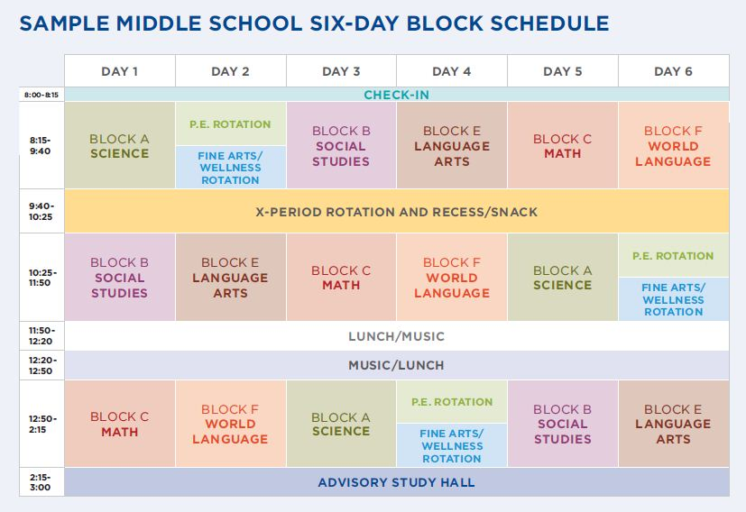
Day in the Life of a MS Teacher

Slide 21
What makes Middle School Teachers Marketable?
Not many students pursue middle school certification
Hold other certifications (elementary and/or secondary)

Slide 22
Becoming a Special Education Teacher
Presented by Dr. Joseph Harvey
Director of Special Services
New Providence School District

Slide 23
Introduction
By law, all students are guaranteed a Free and Appropriate Public Education (FAPE) in the Least Restrictive Environment (LRE).
Students who are determined to be eligible to receive special education services most often do not learn in the same way as other students, and require additional supports that are specialized and individualized.
Special Education teachers provide this specialized instruction and are able to provide accommodations and modifications to enable their students to make meaningful progress in their education.

Slide 24
Special Education in New Providence
Located in Union County, New Providence is a small district with approximately 2400 students. There are 2 elementary schools (grades Pre-K to 6), and a combined Middle/High School. There are approximately 300 students currently receiving special education services. The District currently offers an array of available programming including:
Pull out Replacement settings
In Class Support classes (ICS)
In Class Replacement (ICR)
Self Contained classrooms

Slide 25
Special Education in New Providence
There are currently 29 special education teachers employed by the district.
Many of these teach some replacement sections (either pull out or in class), as well as some In Class Support sections.
Elementary teachers tend to teach multiple subject areas to one or two grade levels, while secondary teachers tend to teach one primary subject area to an array of grade levels.
At times, appropriately certified teachers have moved between regular and special education class assignments.

Slide 26
Certification Requirements
Special Education Teachers need a Students with Disabilities Certificate (Code 2475)
This requires a co-certificate in another area, meaning that the teacher is certified to teach special education classes in the area in which they are certified.
Teachers with the Students with Disabilities certification may be used in support settings outside their other area of certification,
Please refer to the state website, www.nj.gov/education, in the certification and induction section, for more information on the certification process.

Slide 27
Role of a Special Education Teacher
Can provide services to students between the ages of 3 and 21 (Pre-K through 12+)
Can work in public and private settings.
Within these settings, special education teachers can provide:
Replacement Instruction (in class and pull out): Modification of the curriculum
In Class Support: Providing Specialized Support in a mainstream setting (Co-Teaching)
Skill support: Providing additional support in work completion, skill building, organization, etc.
Special education teachers may work in programs that can range from fully mainstreamed to fully self-contained.

Slide 28
Qualities of a Special Education Teacher
Special education teachers generally work with the students who are most in need of support in a school setting. These students typically learn differently from other students, and encounter roadblocks that interfere with the typical learning process. Therefore, special education teachers must:
Be strong educational advocates
Be strong in educational theory and learning strategies
Know how to break down tasks into small parts
Be able to think outside the box
Be able to collaborate with school officials and parents
Believe that every child can learn

Slide 29
Getting a Job in Special Education
Highly competitive job market
Districts value versatility in teachers: the more flexible you (and your certification) are, the better your chances at finding a position
Having a special education certification helps significantly with this
Consider starting your career as a paraprofessional:
Exposure to special education settings enhances your professional development
Chance to establish yourself in a district
Also consider work as a substitute or leave replacement teacher
Consider becoming trained in a specialized reading program such as Wilson, Orton-Gillingham, etc.

Slide 30
Interview Tips
Proofread your application materials!
Personalize your materials for the district/position that you are seeking.
Research the district to which you are applying, including the programs that they use.
Use specific and relevant anecdotes to supplement your answers.
Prepare questions for the interviewers.
Demonstrate an understanding of learning disabilities and special education theory.

Slide 31
Conclusion
Being a special education teacher is challenging, and requires innovation and problem solving in order to help a student demonstrate his or her strengths while building up areas of weakness. While difficult work, it is immensely rewarding to see your students progress, develop, and prepare for the world outside of school.
If you have any questions, feel free to email me at jharvey@npsdnj.org.
Thank you for your time, and good luck!

