Slide 1
Creating an Environment that is Usable by All
Presented by:
Bill Welsh,
Associate Vice President, Rutgers University

Slide 2
Outline for Today
Introduction
Key Terms and Laws
Universal Design Concepts
Accessible Technology and Information
Tips on Creating Accessible Documents
Creating Strategic Plans for Change

Slide 3
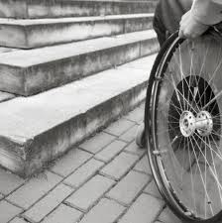
The Impact of the ADA
In 1990, the Americans with Disabilities Act (ADA) was passed.
Prior to the law being enforced, this was the norm.

Slide 4
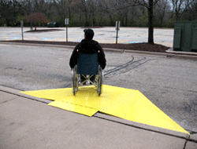
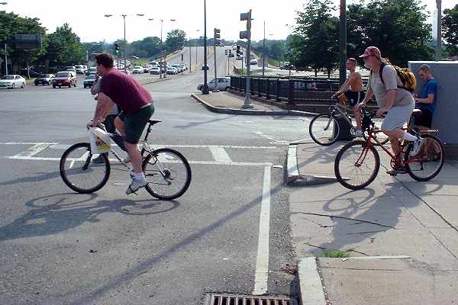
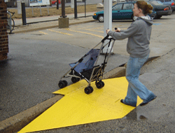
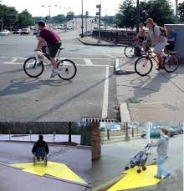
Design that Helps Everyone

Slide 5
Statistics
Within higher education, 11% of all postsecondary students had a disability.
People with disabilities complete college at a lower rate than non-disabled.
Significant increase in enrollment in college,
The nation's largest minority group, and the only group any of us can become a member of at any time.
The single largest minority group seeking employment in today's marketplace

Slide 6
Overview of Disability Laws
The ADA, 1990 and amendments of 2008
Section 504 of the Rehabilitation Act, 1973
Section 508 of the Rehab. Act added in 1986.
All are laws or standards that provide guidelines, but meeting these guidelines may not mean equally effective or usable.

Slide 7
General Comments
Too much emphasis on the law
Need more emphasis on usability and design for everyone
Accessibility and usability are everyone’s responsibility, not just disability services.
Being proactive increases revenue and provides access for people from many groups
Vision for the future: Proactive design for everyone rather than accommodations

Slide 8
Universal Design
The design of products and environments that are usable by all people without adaptations needed
Simplify life for everyone
Making products that are useable at no extra cost

Slide 9
Accessibility and Usability
Accessibility is about ensuring an equivalent experience for people with disabilities.
Usability is about designing products to be effective, efficient, and satisfying.
Usable accessibility combines usability and accessibility to develop positive user experiences for everyone.
Source: World Wide Web Consortium (W3C)

Slide 10
Our own use of Technology
Now, what if all of this technology was completely useless to you?
How would you feel?
How would you order online products?
Check email?
How would you work?
Your thoughts on this experience?

Slide 11
Changes in use of Technology
Students with disabilities are utilizing technology at astounding rates as are other students.
Classrooms have many different technologies both for Online and Resident Instruction courses.
Creates new difficulties for students with disabilities and compatibility with assistive and adaptive technologies

Slide 12
Common Assistive Technologies
Screen Readers:
Screen Reader Demo
Text Readers:
Kurzweil Text Reader Example

Slide 13
Using Captioning
Captioning Video
Therefore:
Provide synchronous captioning
Hire a Sign Language interpreter or Computer Aided Real Time Captioning for training events when requested.

Slide 14
Creating Accessible Documents
Word Documents:
Create Alt text for images
Use Heading Styles
Make tables accessible
Check for accessibility issues
Accessibility features convert to PDF or HTML documents

Slide 15
Accessible Power Points
Use the design layouts within Power Point which are all accessible
Add alternative descriptions to images
Use a unique title for each slide
Include closed captioning for videos
Use the accessibility checker to check for issues
Hyperlinks should be meaningful and not url’s

Slide 16
Additional Resources
Accessible Web Pages:
W3C
Accessibility.Rutgers.edu
http://webaim.org/Aim
Web Forms
Accessible links
Free Accessibility checkers:
The Wave Toolbar
10 Free Web Accessibility Checkers

Slide 17
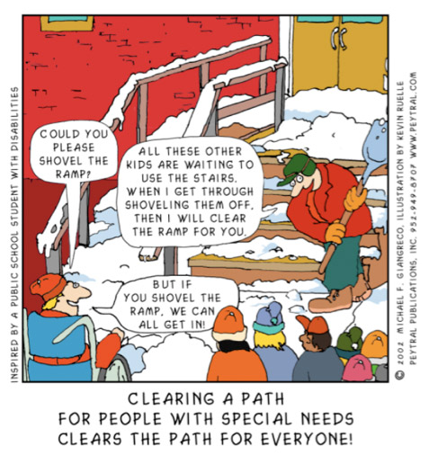
Closing Remarks

