Slide 1
Invisible Injuries of Contemporary Warfare
Elizabeth Daly, Ph.D.
January 18, 2017
Notes:
Intro
Today we’ll be talking about mental health issues that veterans might face as a result of their time in the service, and how those issues might impact them when they return to school.

Slide 2
Agenda
Military Training & Experience
Adjustments to Civilian Life
“What is PTSD? What is trauma?”
Impact of PTSD
Discussion
“How can I help?” – Resources
Q & A
Notes:
First we’ll touch on military culture, training, and experiences, and then discuss how those could impact any Veteran student, regardless of whether or not they have a resulting mental health diagnosis.
Then we’ll get into more specific mental health issues that can be caused by military experiences, focusing primarily on Posttraumatic Stress Disorder. So what PTSD is, and how it could impact students.
Finally, we’ll talk a bit about ways that educators and administrators, and even other students, can help and work with Veteran students.
So first, let’s start with Military Culture

Slide 3
Military training & experience
Plan for Everything
Control Everything
Mission Focus/Compartmentalizing
Emotional Numbness
Notes:
Members of the military are trained to plan for everything, try to control everything they can, focus on the mission at hand, compartmentalize what isn’t necessary or detracts from mission accomplishment, and to numb their emotions so they don’t get in the way.
These attitudes are ingrained in service men and women because it helps them survive the unique experiences they will face, both physically and emotionally. These values are specifically designed to help make service members effective in combat and deployed situations, but all service members are trained to value these attitudes regardless.
And there are a number of unique situations that these attitudes can be really adaptive for…

Slide 4
Military training & experience
Being under attack, or threat of attack
Handling of human remains
Killing an enemy, or non-combatants
Seeing fellow soldiers / friends dead or injured
Helpless to stop violent situations
Witnessing or experiencing sexual assault
Powerlessness (e.g., over choices, options)
High work demand
Separation from family/support network
Notes:
(list out), and many more.
Some of these are specific to combat situations, but not all of them. Regardless of whether or not Veterans were deployed or in combat, there are many situations that could be distressing.

Slide 5
It could be hard for a Veteran to…
Notes:
As a result of having been through such experiences, Veterans may have difficulty adjusting to life as a civilian. For example, Veterans might have difficulty…

Slide 6
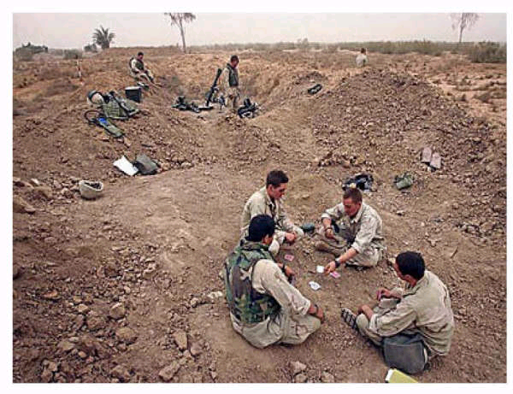
It could be hard for a Veteran to…
listen to his/her child whine about being bored

Slide 7
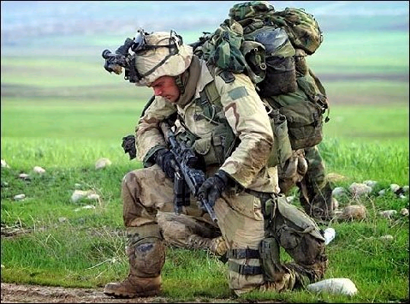
It could be hard for a Veteran to…
listen to someone complain about the heat

Slide 8
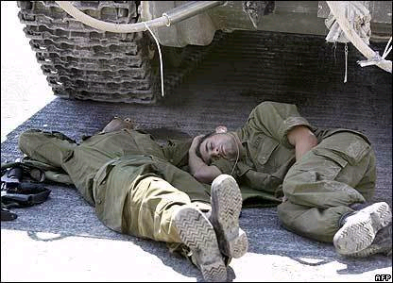
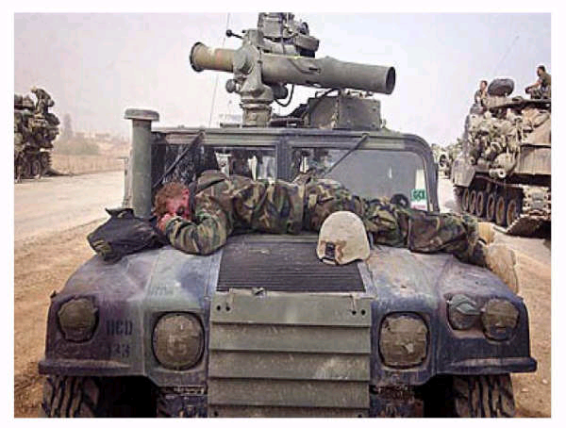
It could be hard for a Veteran to…
understand when co-workers complain about getting a bad night’s sleep

Slide 9
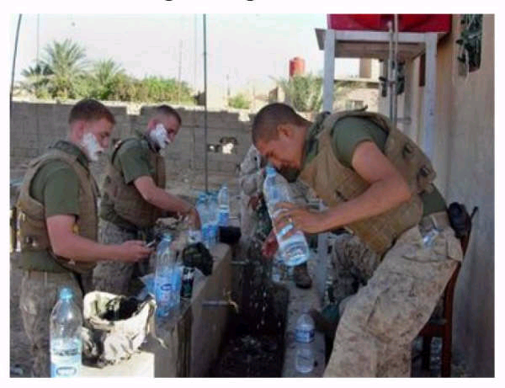
It could be hard for a Veteran to…
be tolerant when other complain about the hassle of getting ready for work

Slide 10
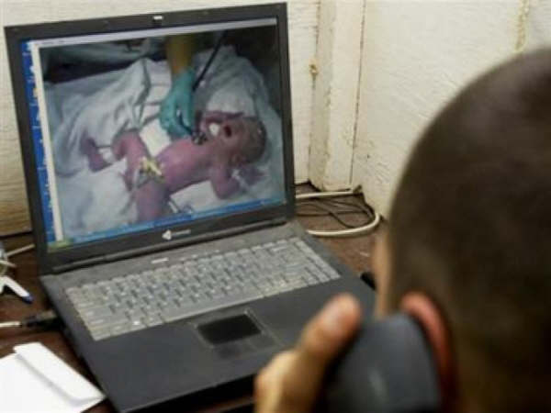
It could be hard for a Veteran to…
be sympathetic when someone talks about how hard it is to have a new baby in the house

Slide 11
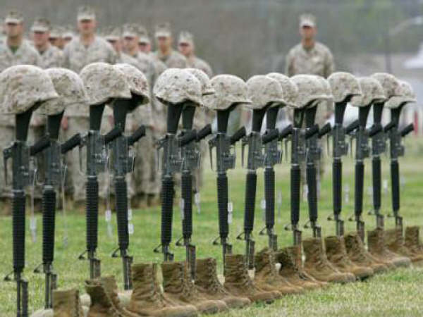
It could be hard for a Veteran to…
control his/her emotions when someone says the war was a failure

Slide 12
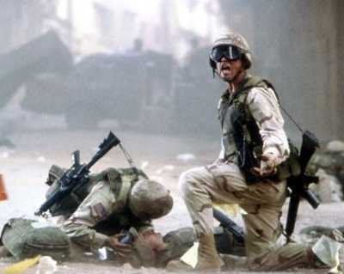
It could be hard for a Veteran to…
focus on a lecture about economics

Slide 13
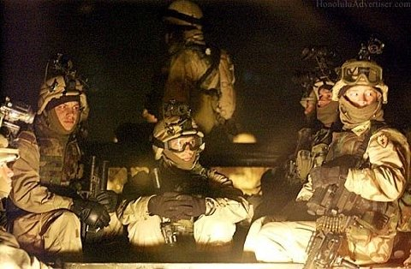
It could be hard for a Veteran to…
sleep through the night

Slide 14
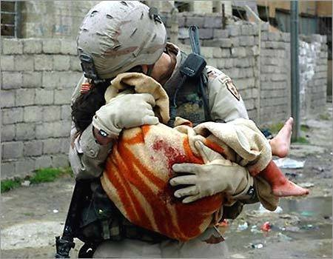
It could be hard for a Veteran to…
forget the things he/she has seen and done

Slide 15

It could be hard for a Veteran to…
feel comfortable with a stranger behind him/her

Slide 16
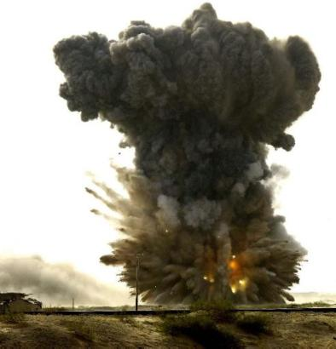
It could be hard for a Veteran to…
remain calm with loud noises

Slide 17
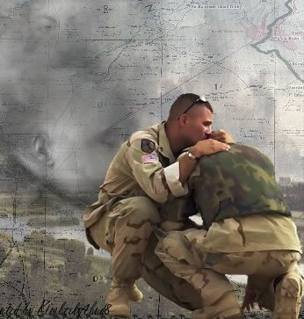
It could be hard for a Veteran to…
make new friends

Slide 18
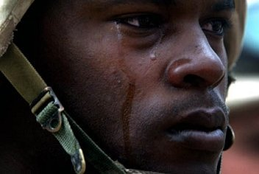
It could be hard for a Veteran to…
remember how life was before joining the military
Notes:
A large number of service members join the military during their formative years in late-adolescence and early 20s, so sometimes there isn’t much to remember beforehand, and the military might become very ingrained in their identity.
Those slides showed a lot of negative experiences service men and women may encounter, and it makes sense that it might be difficult to adjust to civilian life after such negative experiences.

Slide 19
Military training & experience
Camaraderie
Being there for one-another, faith in your team
Lots of structure
Black-or-white guidelines about how to act and how things work
Working for the greater good, sense that work has value and is important
Being a part of something greater than yourself
Notes:
But there are also a lot of positives to being in the military, and even those can cause adjustment difficulties. For example, the military often involves…
However, while the military does a great job preparing servicemen and women to work, survive, and thrive in the military, there is little-to-no training on leaving. Veterans often find themselves

Slide 20
The military effect
Grief for the loss of camaraderie
More independence from others
Lacking a common goal
Feel a loss of purpose/meaning in activities
Confusion about how to act (the “gray areas”)
Difficulty adjusting to having less structure
Have an identity crisis, not know who he/she is
Desire to return to combat
Notes:
Therefore, as a result of leaving a positive environment, veterans may experience…
All branches of the military do a wonderful job preparing their service men and women to survive and thrive in the military setting. But Veterans receive little-to-no training on getting out, leaving some things about life after the military hard to accept and deal with.
So as I mentioned, the issues I‘ve been talking about could happen to any military service member...men and women, deployed or not, combat-experience or not. But, the issues that Veterans experience as a result of their military service sometimes extends beyond these issues, and may contribute to formal mental health diagnoses.

Slide 21
Mental health issues
Depressive Disorders (5-13%)
Anxiety Disorders (6%)
Insomnia Disorders (40-80%)
Mild Traumatic Brain Injury (13-23%)
Substance Use/Misuse (5-15%)
Psychosocial Problems (13%)
PTSD (5-25%)
~8% in general population
75-95% do NOT develop PTSD
Notes:
For example, around 5-13% of Veterans have been given a formal diagnosis of a depressive disorder, like Major Depression or Persistent Depression.
(continue listing)
And finally, Posttraumatic Stress Disorder, or PTSD, which people often associate with the military. 5-25% of Veterans have a PTSD diagnosis. It is important to note that this means at least 75% of Veterans DO NOT have PTSD. Having the adjustment difficulties we have already discussed is not an indication of PTSD.
But still, PTSD is more prevalent in Veterans than in the general civilian population, where it has prevalence rates of about 8%. In fact, the VA is often considered a frontrunner in PTSD research and treatment as a result.
Because some of the disorders mentioned on this list are a little more common/understood/”accessible” to non-military members (like depression or anxiety), we are going to focus the remainder of our talk on PTSD specifically. Additionally, all of the disorders here are related to, and often comorbid with, PTSD. So while all of the disorders on here are worth discussing, and we could probably discuss them each at great length, we will keep it to PTSD for now, especially because it is so often a misunderstood disorder.

Slide 22
What is PTSD?
Emotions “naturally” recover and decrease
e.g., less excited 1 year after a promotion than initially
Going through distressing experiences can change how we think and feel
PTSD is what we call it when the natural emotional recovery process gets “stuck”, and when our thoughts don’t “change back”
Avoidance / lack of emotional processing
Continued “survival mode”
Reality ≠ expectations
Notes:
Let’s start with “what IS ptsd?” My associate will describe it in more detail momentarily. But first, I want to touch on what PTSD is more conceptually.
So first, lets start with 2 basic facts about emotions:
…This can happen for a number of reasons, and there are multiple theories, all of which have merit simultaneously, about how/why the recovery process gets “stuck”.
We know that in order for emotions to “naturally” decrease/recover, we have to actually let ourselves experience them. Research has shown fairly conclusively that avoiding emotions prevents them from being properly “processed” so that they can decrease
We can also think of PTSD as “continued survival mode”. Broadly speaking, PTSD is what we might call it when the instincts, thoughts, and emotional and physical experiences that someone automatically goes through during a distressing situation DON’T STOP. People will automatically associate things like loud noises with the “fight-or-flight” response, and continue living as if all loud noises, even fireworks, mean danger. For a variety of reasons, people with PTSD may not have experiences to “unlearn” that association.
Finally, we can think of PTSD as what might occur when what we think should happen does not match what actually happens. We know that people feel uncomfortable when reality doesn’t match expectations, and people will make mental leaps to make sense of things. Many distressing experiences involve things that “don’t make sense” (e.g., an innocent child getting shot or abused), and trying to find a way to make sense of it might lead to the continuance of PTSD symptoms and prevent that natural emotional recovery process.
So that’s all conceptually…but what about more specifically? How do we diagnose PTSD?

Slide 23
What is PTSD?
PTSD requires a traumatic event (or repeated events)
An event that is traumatic for one person is not always traumatic for another person.
Not all trauma leads to PTSD.
PTSD is not the only diagnosable condition following a traumatic event
Sometimes events that don’t bother us at first bother us later in life.
PTSD is treatable & symptoms can go away
Notes:
According to DSM-5

Slide 24



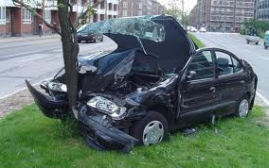
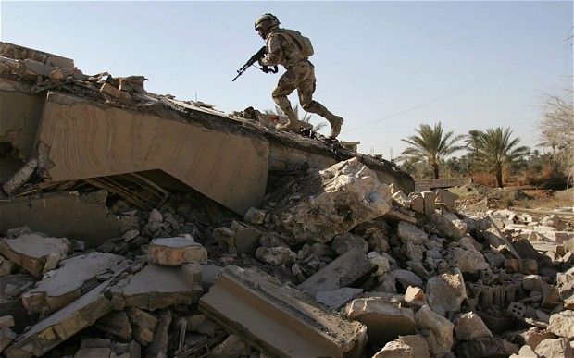

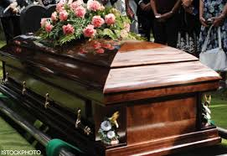
What is trauma?
Types of trauma include:
Violence
Accidents
Physical assault
Sexual assault
Natural disasters
Loss of a loved one or grief
May be combat/military-related
Notes:
According to the DSM-5, these are the types of events that can qualify as traumatic.
In order to get a PTSD diagnosis, an individual must, in some way, experience one of these types of events. That is, they must in some way encounter serious actual or threatened death or injury. But then we have to ask “what does it mean to “experience” or “encounter” an event?”

Slide 25
PTSD Diagnostic Criteria
A. Experienced or witnessed a traumatic event - exposure to actual or threatened death, serious injury, or sexual violence in one or more of the following ways:
Directly experiencing the traumatic event(s).
Witnessing, in person, the event(s) as it occurred to others.
Learning that the traumatic event(s) occurred to a close family member or friend.
Experiencing repeated or extreme exposure to aversive details of the traumatic event(s) (e.g., first responders collecting human remains, police officers repeated exposed to details of child abuse). Does not apply to exposure through electronic media, TV, movies, or pictures, unless such exposure is work related.
Notes:
DSM identified four ways one might “experience” a traumatic event that could lead to PTSD…
Note: Criterion A4 does not apply to exposure through electronic media, television, movies, or pictures, unless this exposure is work related.
Essentially, what this means is that you can be directly involved in it, see it happen, or learn about and be affected by it.
The question I typically ask to begin assessing whether someone has encountered one of these situations is:
“Have you every experienced, witnessed, or had to deal with an extremely traumatic event that involved actual or threatened death or serious injury to you or someone else?”
The following criteria apply to adults, adolescents, and children older than 6 years.
But just experiencing a traumatic event doesn’t necessarily mean one will develop PTSD; you could go through it and be fine. So what are the symptoms/signs of PTSD?

Slide 26
What are PTSD symptoms?
Feel numb, maybe cry a lot
Feel angry, guilty, ashamed
Hard to feel love, happiness, or any positive emotion
Irritable
Always on edge, watching your back
Jumpy, on your guard
Can’t stop thinking or dreaming about the trauma
Traumatic Stress
Notes:
These are some of the common symptoms.
But actually the list goes on…there are many symptoms/signs of PTSD. And it may not seem like it, but they can be pretty easily grouped into 4 categories...

Slide 27
What are PTSD symptoms?
4 Symptom Clusters:
Re-experiencing
Avoidance
“Negative” Changes in Thoughts and Mood
Arousal

Slide 28
PTSD Diagnostic Criteria
B. Re-experiencing symptoms
Recurrent, involuntary, and intrusive distressing memories of the traumatic event(s)
Recurrent, distressing dreams directly related to the event(s)
Flashbacks in which the individual feels or acts as if the traumatic event(s) was truly happening in the here-and-now
Intense or prolonged emotional distress when reminded of the traumatic event(s)
Marked physiological reactions when reminded of the traumatic event(s)
Notes:
All of these symptoms have to do with the traumatic experience(s) continuing to “come back to you”. It’s not actually re-living the event, but it can feel like it to some people. The event can come back to you in a number of ways…

Slide 29
PTSD Diagnostic Criteria
C. Avoidance symptoms
Avoidance of, or efforts to avoid, distressing memories, thoughts, or feelings related to the traumatic event(s)
Avoidance of, or efforts to avoid, external reminders of the traumatic event(s) (e.g., people, places, conversations, activities, objects, situations)
Notes:
Next group/type of symptoms involves avoidance, and in a way this is the core aspect of PTSD. People with PTSD typically avoid what we call “internal reminders”, because they are distressing. And/or they avoid “external” reminders, because they bring up distressing “internal reminders”.

Slide 30
PTSD Diagnostic Criteria
D. “Negative” changes to thoughts and mood
Inability to remember an important aspect of the traumatic event(s)
Persistent and exaggerated “negative” beliefs about oneself, others, or the world
Persistent, distorted thoughts/beliefs about the cause or consequences of the traumatic event(s)
Persistent “negative” emotional state (e.g., fear, horror, anger, guilt, or shame)
Diminished interest or participation in significant activities
Feelings of detachment or estrangement from others
Persistent inability to experience “positive” emotions
Notes:
I mentioned that going through traumatic experiences changes how we think and feel. With PTSD, those changes are, perhaps obviously, “negative”. I use quotes because I try not to label/judge emotions and thoughts as “bad” or “good”. So “negative” and “positive” here are referring to the “valence” of the emotions/beliefs.

Slide 31
PTSD Diagnostic Criteria
E. Arousal symptoms
Irritable and angry outbursts
Reckless or self-destructive behavior
Hypervigilance
Exaggerated startle response
Problems with concentration
Sleep disturbance (e.g., difficulty falling or staying asleep or restless sleep)
Symptoms persist for more than 1 month.
Symptoms are severely distressing and/or significantly impair functioning in social, occupational, or other important areas of life.
Notes:
Finally, the last group of symptoms has to do with arousal, by which I mean physiological arousal, like feeling “up” or “on”. That can come out in a number of different ways…
And finally, it’s normal experience a great deal of the various symptoms I’ve jsut described immediatly following a traumatic event. But to receive a PTSD diagnosis, all four types of symptoms I just described must stick around more for than 1 month. Additionally, the symptoms must be really distressing to the individual, and/or must get in the way of her/his life.

Slide 32
Impact of PTSD
Common adjustment issues reported by Veterans with PTSD:
Difficulty concentrating (school, work, etc.)
Overwhelmed by activities in public spaces
Feeling less connected to others
Withdrawing from relationships
Volatile professional and personal relationships
Disturbed sleep
Fatigued
Alcohol and substance abuse
Notes:
So based on the typical symptoms that Veterans with PTSD might experience, it’s not difficult to anticipate some of the more common adjustment issues…
With regard to alcohol and substance abuse, important to keep in mind that people may not just be using for the “high”, but rather just to feel “normal” and to manage symptoms like severe anxiety, anger, or hypervigilance (e.g., marijuana is commonly used by people with PTSD because it reduces vigilance).

Slide 33
Impact of PTSD
Real costs of PTSD – physical, emotional, social, professional, academic, etc.
Why not seek treatment?
Messages about mental health from family, community/peers, military
Stigma
Confidentiality
Time, too many demands
Finances
Concern about whether treatment will work
May not realize the distress/impact
PTSD symptoms – avoidance, distrust, etc.
Notes:
Veterans may have academic difficulties, cognitive difficulties or psychological difficulties unrelated (or partially related) to their service.
“What will my family say?” / “What would my boss do if he knew?”…
PTSD sxs themselves are barrier, military culture

Slide 34
Impact of PTSD
Discussion: How do PTSD symptoms affect student Veterans? When returning home, a service member may find it hard to…
Notes:
So how might PTSD affect student Veterans, specifically? How might PTSD, or even common adjustment issues in general, manifest in the classroom or academic setting?

Slide 35
Impact of PTSD
Problems with attention and concentration due to insomnia and feeling “on edge”
Chronic pain – difficult to sit for long periods
Sensitive to war references – easily angered
Feeling “different”, causing social isolation or interpersonal difficulties
Impatience/anger with academic paperwork process
Discomfort in crowds (standing in line, big classrooms, cafeterias), or closed spaces
Lack of structure may be overwhelming
Sleep difficulties → reduced ability to consolidate memories, may take longer to complete assignments → lower scores, frustration
Notes:
Everyone experiences trauma differently! PTSD can look diff in diff people (e.g., not everyone has the same exact sxs)

Slide 36
How can I help our student Veterans?
What to do? Get their “BACK”:
Be mindful
Ask questions (be brave!)
Check-in / follow-up
Keep a list of helpful resources
Notes:
Don’t assume all Vets have PTSD. Trauma is much more common than PTSD and not all signs of PTSD mean “PTSD”. Lots of things can look like it (e.g. depression, general adjustment, PTSS).
But don’t sweat it. Distinguishing the nuances between diagnoses is up to trained clinicians. So if you are unsure, don’t make assumption.
Instead, get their “back”. Credit to a graduate student who presented this with me previously for coming up with that.
BE MINDFUL
- Now that you know all this info on PTSD, watch for signs of posttraumatic distress, any mental health-related distress, or even just general signs of difficulty adjusting to student life
- Keep an ear out for students complaining about their sleep, talking about being overwhelmed, not being able to concentrate, having relationship/roommate/professor problems; those are typical chief complaints/presenting problems, not “oh my trauma has really been bothering me lately”
ASK QS
Don’t be afraid to ask Qs! Beyond “how are you doing?” or “how is school?” …depending on what you’re observing and depending on your level of relationship with the student, “I’ve been noticing you seem a little tired lately. How has your sleep been?” / “I’ve been noticing that you seem a little down lately. How are you feeling?”
If you aren’t sure what you are seeing/picking up on, ASK! Or, preemtively, when you find out a student is a Veteran, maybe pull her/him aside and ASK if there is anything you can do or if there is anything that would be useful for you to know as their teacher/administrator, etc. Everyone is different, and each individual will be the best source of EXACTLY WHAT it would mean to “have their back”.
Additionally, do not be worried if you do not have military experience yourself. One of my favorite shows had this great lesson: sometimes the best thing to say is “I know I don’t know, but I’d like to try to understand.” Acknowledge their experience, and seek to connect.
CHECK IN
KEEP asking questions/checking in with that student! Whether it’s an email, a phone call, or asking the next time you see them…
Consider checking in with Veteran throughout course (perhaps via email).
Many will not ask for accommodations or speak up when they are having difficulties.
Anticipate difficult/sensitive issues and check in how they would like these to be handled.
RESOURCES
Under ADA, PTSD diagnosis = qualified for disability services in a workplace or at school

Slide 37
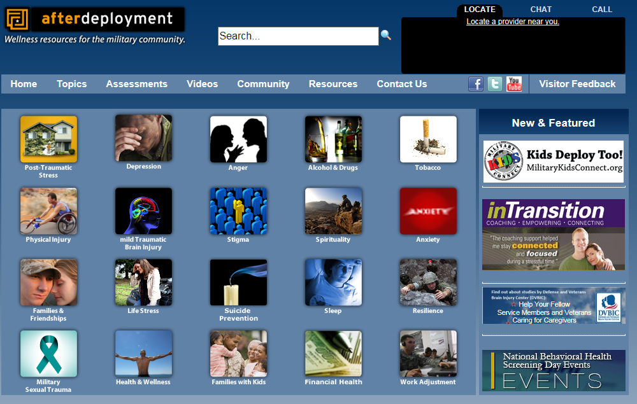
Resources
→ Afterdeployment.org
Notes:
Afterdeployment.org – Can locate a provider, print off info
Wellness resources for the military community
https://afterdeployment.dcoe.mil/

Slide 38


Resources
College Counseling Center: 732-906-2546
M/TH: 8am-8pm; T/W/F: 8am-5pm
Drop-in hours: (TBA?)
Counselor for Students with Disabilities:
Edison Hall, room 100
732-906-2546
Adapted Testing Center
Johnson Learning Center, room 229
732-906-2547
Veterans Crisis Line: 1-800-273-8355, Press 1
Local VA Medical Centers, Vet Centers, and VA Community-Based Outpatient Programs
Notes:
Thus far, the “how to help” section has been focused on the the difficulties/struggles that student Veterans might experience. But student Veterans bring so much more to the classroom than just potential traumas and adjustment issues…because, as I discussed earlier, there is so much more to the military service than just the difficult parts. There are a lot of positives!

Slide 39
How can I help our student Veterans?
Remember the positives!
Skills/strengths student Veterans bring to the classroom:
Leadership skills
Ability to work in teams
Desire to help others
Goal oriented
Thorough/detail oriented
Try to create a sense of purpose (vision)
Be creative
Notes:
Easy to focus on what is “wrong”, because it can seem more “important”. But there are many who would argue that that isn’t true. Veterans bring a lot of skills and strengths to the classroom, and focusing on bringing these out can help Veterans far more than you might expect. For example., Veterans often have tremendous…
Focusing on these strengths might help student Veterans connect with their new environment, find purpose and use for their skills and strengths, and maybe even feel like they “belong”. There is no civilian experience that I know of that can truly recreate being in the service. But by creating an environment where there is a mission, a vision, and where Veterans are able to use their special skills, we can help them feel capable and “in place”, which themselves can strongly combat and decrease a lot of the symptoms I have been describing.
IME, Veterans are very perceptive, and can tell “when someone really cares”. By doing these things (being mindful, asking, checking-in, being ready to help, focusing on their strengths, and providing a vision for their work), you will be attempting to connect with the students, which can make a world of difference.

Slide 40
Questions?
Thank you:
Richard Feldman coordinator, Veterans Service Center
Mary Katherine Howell psychology graduate student
Trokon Fiawoo Operation College Promise
VA trauma pre/postdoctoral training program
And all of you, of course!
Notes:
That’s it for my talk. I’m happy to take any questions, but first I’d like to say thank you to Richard Feldman for inviting me here to speak today, as well as several others involved in the making of this presentation, and all of you, of course.

