Slide 1
Psychiatric Disabilities: Struggling with Mental Health in the Classroom
Jason Holmwood, M.A., M.S., CCTP
Sheema K. Majiduddin, Ed.M., CCTP
COUNSELING SERVICES
EDISON HALL 100
Notes:
Intro: Sheema & Jason

Slide 2
Themes for today:
Understanding this population of students
Treat students with mental illness the same as any other student
Warning signs of mental illness
Reduce stigma by humanizing
Role models that create culture of acceptance in classroom
Notes:
Jason

Slide 3
How would you recognize a student with mental illness in your classroom??
Notes:
Sheema:
Why are we talking about this. Why does this matter. Because of relationships and the role it plays in helping students persist. Stigma

Slide 4
What is a Disability According to the Americans with Disabilities Act (ADA)?
"a physical or mental impairment that substantially limits one or more major life activities of such individual."
"Major life activities" involves such things as self-care, basic bodily functions, seeing, walking, and communicating.
Physical
Medical disorder
Visual, movement, Hearing
Mental
Learning Disability
Emotional Disability
Notes:
Sheema

Slide 5
Which Disabilities are common at MCC?
Autism Spectrum Disorders
23/2%
Speech/Language Impairment
23/2.5%
Intellectual Disabilities
26/3%
ADHD
86/11%
Learning Disabilities
435/54%
Psychiatric (Emotional/Behavioral) Disabilities
49/6%
Physical/Health Disability
29/3%
Multiple
134/36%
Notes:
Jason: Multiple most have psychiatric disability Autism Spec, and ADHD have a high comorbidity with Psychiatric Disabilities. And SLD - experience

Slide 6
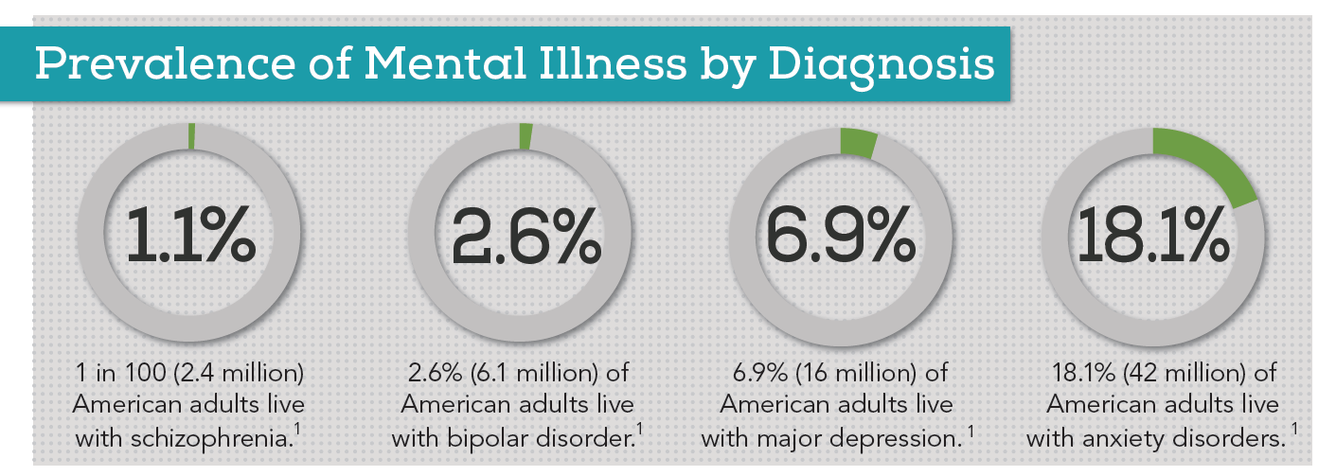
1 out of 3 college students reported prolonged period of depression***
***Association for University & College Counseling Center Directors survey.
Notes:
Sheema

Slide 7
Center of Collegiate Mental Health
Founded by Penn State University
Largest and most representative study of its kind
Over 230,000 students surveyed
2800 professional clinicians involved in the study
Summarizes trends in college student mental health during the last 6 years
Trends to note:
Rates of self-injury and serious suicidal ideation appear to be increasing; and
Rates of sexual assault, harassment and treatment for drug/alcohol abuse appear to be decreasing slightly.
Notes:
Jason

Slide 8
Penn State Study
Findings showed that:
1 out of 3 have seriously considered suicide
1 in 10 have been hospitalized for psychiatric reasons
1 out of 4 have self-injured
Nearly 1 in 10 have made a suicide attempt
1 out of 5 have experienced sexual assault
1 out of 3 have experienced harassment or abuse
1 out of 3 have experienced a traumatic event.
Notes:
Sheema

Slide 9
Penn State Study: 10 Primary Presenting Concerns of Students
1. Anxiety
2. Depression
3. Relationship problems
4. Stress
5. Academic performance
6. Family
7. Interpersonal functioning
8. Grief or loss
9. Mood instability
10. Adjustment to a new environment
Notes:
Jason

Slide 10
Penn State Study
“Academic distress is strongly associated with nearly half of college students’ mental health concerns. As such, reducing mental health distress in college students has direct implications for their academics”
Notes:
Sheema
***Michigan state study
Mention that most symptoms we are going to discuss will not typically present themselves in class. There will be times when students are under particular distress, off their meds, etc that you will notice significant changes.
Next Slide: IMPORTANT: We will be discussing symptoms and it is important to note that sometimes students my present these symptoms who do not have a mental illness.

Slide 11
Acute and Posttraumatic Stress Disorders
Aside from the differences in onset and duration, the symptoms of acute stress disorders and PTSD are almost identical:
Reexperiencing the traumatic event
Avoidance
Reduced responsiveness
Increased arousal, negative emotions, and guilt

Slide 12
Anxiety Disorders
Most common mental disorders in the U.S.
In any given year, 18% of the adult population in the U.S. experiences one of the anxiety disorders identified in DSM-5
Close to 29% develop one of the disorders at some point in their lives
Only one-fifth of these individuals seek treatment
Most individuals with one anxiety disorder also suffer from a second one as well

Slide 13
Generalized Anxiety Disorder (GAD)
Characterized by excessive anxiety under most circumstances and worry about practically anything
Sometimes called “free-floating” anxiety
Symptoms include: feeling restless, keyed up, or on edge; fatigue; difficulty concentrating; muscle tension, and/or sleep problems
Symptoms must last at least three months

Slide 14
Disorders of Mood
People with depressive disorders suffer only from depression, a pattern called unipolar depression
Person has no history of mania
Mood returns to normal when depression lifts
In contrast, those who display bipolar disorders experience periods of mania that alternate with periods of depression

Slide 15
What Are the Symptoms of Depression?
Symptoms may vary from person to person
Five main areas of functioning may be affected:
Emotional symptoms
Feeling “miserable,” “empty,” “humiliated”
Experiencing little pleasure
Motivational symptoms
Lacking drive, initiative, spontaneity
Between 6% and 15% of those with severe depression die by suicide

Slide 16
What Are the Symptoms of Depression?
Five Domains Cont.
-Behavioral symptoms
Less active, less productive
Cognitive symptoms
Hold negative views of themselves
Blame themselves for unfortunate events
Pessimistic
Physical symptoms
Headaches, dizzy spells, general pain

Slide 17
Diagnosing Bipolar Disorders
Unlike those experiencing depression, people in a state of mania typically experience dramatic and inappropriate rises in mood and activity
People are considered to be in a full manic episode when, for at least one week, they display an abnormally high or irritable mood, increased activity or energy, and at least three other symptoms of mania
In extreme cases, symptoms are psychotic
When symptoms are less severe, the person is said to be experiencing a hypomanic episode

Slide 18
What Are the Symptoms of Mania?
Five main areas of functioning may be affected:
Emotional symptoms
Active, powerful emotions in search of outlet
Motivational symptoms
Need for constant excitement, involvement, companionship

Slide 19
What Are the Symptoms of Mania?
Five main areas of functioning may be affected:
Behavioral symptoms
Very active – move quickly; talk loudly or rapidly
Flamboyance is not uncommon
Cognitive symptoms
Show poor judgment or planning
May have trouble remaining coherent or in touch with reality
Physical symptoms
High energy level – often in the presence of little or no rest

Slide 20
At one time or another, everyone feels stressed, overwhelmed, anxious, depressed or upset.
The following may help to identify some symptoms which, when present over a period of time, suggest that the problems with which the person is dealing are more than the “normal” ones.
Notes:
Jason: IMPORTANT: Sometimes you will have students present these warning signs who do not have a mental illness.

Slide 21
What to watch for…
Marked Change in Academic Performance or Behavior
Poor performance and preparation
Excessive absences or tardiness
Repeated requests for special consideration
Avoiding participation
Dominating discussions
Excessively anxious when called upon
Disruptive behavior
Exaggerated emotional response that is obviously inappropriate to the situation
Notes:
Sheema

Slide 22
What to watch for…
Unusual Behavior or Appearance
Depressed or lethargic mood or functioning
Hyperactivity or very rapid speech
Deterioration in personal hygiene or dress
Dramatic weight loss or gain
Strange or bizarre behavior indicating loss of contact with reality
Observable signs of injury
Notes:
Jason

Slide 23
What to watch for…
References to Stressful Life Events
Problems with roommates, family or romantic partners
Experiencing a death of a significant other
Experiencing a physical or sexual assault
Experiencing discrimination based on gender, race, religion, ethnicity, sexual orientation, or disabilities
Experiencing legal difficulties
Any other problem or situation that is experienced as a loss or stressor
Notes:
Sheema

Slide 24
What to watch for…
References to Suicide, Homicide or Death
Feelings of helplessness or hopelessness
Verbal or written references to suicide
Verbal or written references to homicide or assaultive behavior
Isolation from friends, family and classmates
Suicide is the #2 leading cause of death amongst college students
90% of people who attempt suicide are dealing with diagnosed/undiagnosed mental illness.
Notes:
Jason: Self-Regulation

Slide 25
Relationships Matter
Faculty/staff are in a unique position to identify and help students who are in distress.
This may be particularly true for students who cannot or will not turn to family or friends.
Anyone who is seen as caring and trustworthy may be a potential resource in times of trouble.
Your expression of interest and concern may be a critical factor in helping impaired students reestablish emotional equilibrium, thus saving their academic careers or even their lives.
Notes:
Sheema: Factors that may hinder a student from opening up, receiving help (past experience with a counselor, family shame, ignoring student concern, gender norms, re-traumatization)

Slide 26
What you can do to help?
We all have a different responses to emotional distress
Past History
Coping strategies
Emotional confusion
How we think about the moment
Structuring class from the beginning
Disclaimer/Syllabus
Teachable Moments/Modeling
Controlled Breathing
Tone of Voice
Posture
Word Choice
Notes:
JASON

Slide 27
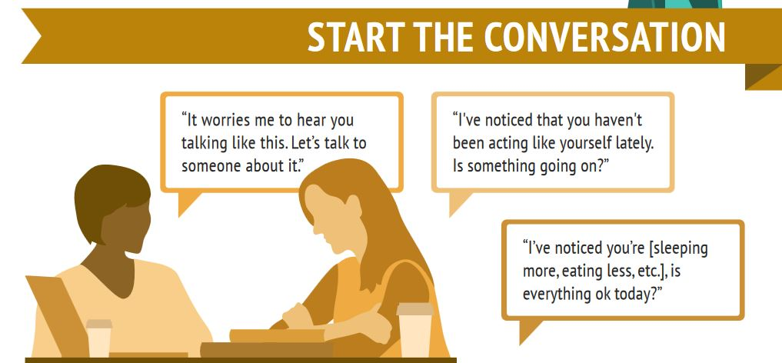
What can you do to help?

Slide 28
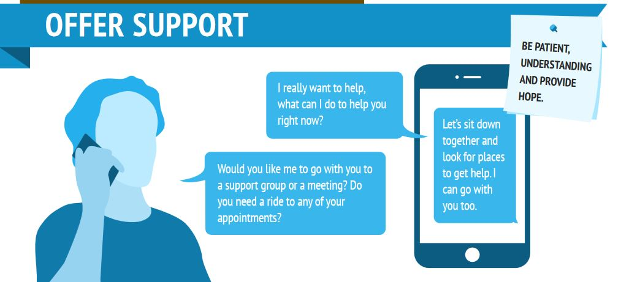
What can you do to help?
We have counseling support on campus. Would you like me to walk you to the counseling center in Edison Hall.

Slide 29
What can you do to help?
Department of Counseling Services
Edison Hall Room 100
732-906-2546
www.middlesexcc.edu/counseling

Slide 30
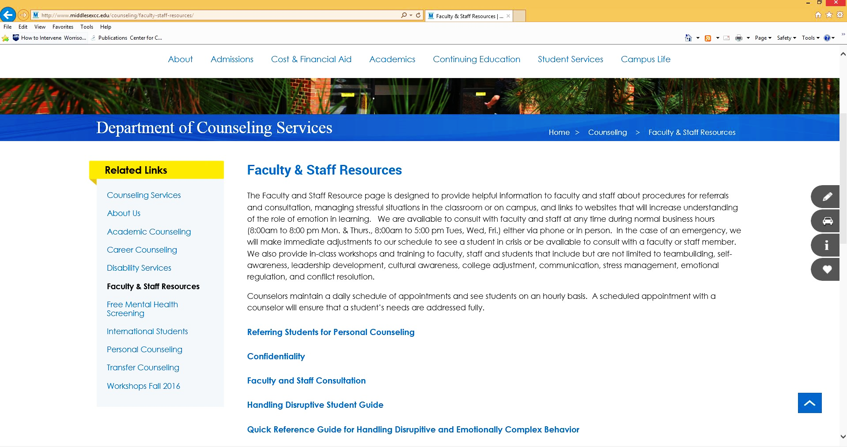

Slide 31
Diagnosing Bipolar Disorders
DSM-5 distinguishes two kinds of bipolar disorder:
Bipolar I disorder
Full manic and major depressive episodes
Most experience an alternation of episodes
Some have mixed episodes
Bipolar II disorder
Hypomanic episodes alternate with major depressive episodes

Slide 32
Acute and Posttraumatic Stress Disorders
The precipitating event usually involves actual or threatened serious injury to self or others
The situations that cause these disorders would be traumatic to anyone (unlike the anxiety disorders)
Acute stress disorder
Symptoms begin immediately or soon after the traumatic event and last for less than one month
Posttraumatic stress disorder (PTSD)
Symptoms may begin either shortly after the event, or months or years afterward
As many as 80% of all cases of acute stress disorder develop into PTSD

Slide 33
How Common Is Unipolar Depression?
Women are at least twice as likely as men to experience severe unipolar depression
Lifetime prevalence: 26% of women vs. 12% of men
Among children, the prevalence is similar among boys and girls
Approximately 85% of people with unipolar depression recover, some without treatment
Around 40% will experience another episode later in their lives

Slide 34
Stress, Coping, and the Anxiety Response
When we view a stressor as threatening, the natural reaction is arousal and fear
Fear is a “package” of responses that are physical, emotional, and cognitive
Stress reactions, and the fear they produce, are often at play in psychological disorders
People who experience a large number of stressful events are particularly vulnerable to the onset of anxiety and other psychological disorders

Slide 35
Anxiety
Although unpleasant, experiences of fear and anxiety often are useful
They prepare us for action – for “fight or flight” – when danger threatens
However, for some people, the discomfort is too severe or too frequent, lasts too long, or is triggered too easily
These people are said to have an anxiety or related disorder

Slide 36
Generalized Anxiety Disorder (GAD)
The disorder is common in Western society
As many as 4% of the US population have symptoms in any given year and ~6% at some time during their lives
Usually first appears in childhood or adolescence
Women are diagnosed more often than men by a 2:1 ratio
Around one-quarter of those with GAD are currently in treatment
A variety of theories have been offered to explain the development of the disorder…

Slide 37
How Common Is Unipolar Depression?
Around 8% of adults in the U.S. suffer from severe unipolar depression in any given year
As many as 5% suffer from mild forms
Around 19% of all adults experience unipolar depression at some time in their lives
The prevalence is similar in Canada, England, France, and many other countries
The rate of depression is higher among poor people than wealthier people

Slide 38
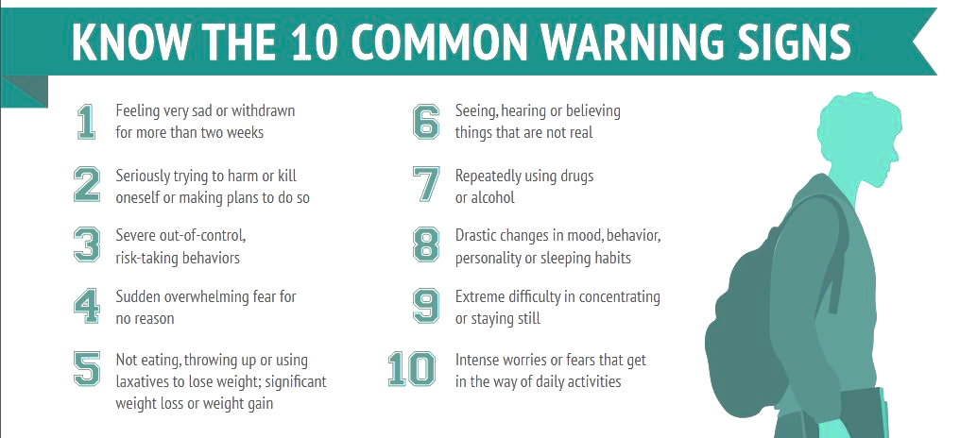
What can you do to help?

