Slide 1
Addressing Sexual Orientation and Gender Identity Issues in the School Environment Safe Schools for All

Slide 2

Primary Message
Addressing anti-LGBT bias in schools makes schools safer for all students, regardless of sexual orientation or gender identity/expression.
Notes:
Define what LGBT means
We can’t stress this message often enough.
This is one of the main reasons why we address this topic with all school staff.
Paula’s daughter’s letter
(Go to next slide for questions to clarify.)
2

Slide 3
Experiences of Youth https://www.youtube.com/watch?v=8Ly8rijlt9M

Slide 4
Reviewing the language Sexual orientation – The inner feelings of who we are attracted to emotionally or sexually Sexual identity – the way we name ourselves in terms of our sexuality-- Identities may be heterosexual, gay, lesbian, bisexual, and other

Slide 5
Gay - identity of a person who is sexually and emotionally attracted to some members of the same sex.
Lesbian - identity of a person who is sexually and emotionally attracted to some other females.
Bisexual - identity of a person who is sexually and emotionally attracted to some females and some males.
Heterosexual – identity of a person who is sexually/emotionally attracted to a person of another sex.

Slide 6
Gender orientation – An individual’s internal sense of their gender (e.g., feeling male, female, or neither). Gender orientation doesn’t necessarily align with the gender assigned at birth.
Gender identity – How we name ourselves in terms of our gender. Identities may be male, female, androgynous, transgender, genderqueer, and others
Gender expression – A person’s observable characteristics that are linked traditionally, to either masculinity or femininity, such as: appearance, dress, mannerisms, social interactions.

Slide 7
Transgender - identity of a person who gender identity is not aligned with their sex assigned at birth and/or whose gender expression is non-conforming.
Cisgender –Identity of a person whose gender identity is aligned with their sex assigned at birth.

Slide 8
Distinguishing among four human characteristics
Biological sex (assigned sex)
Gender identity
Sexual orientation
Gender expression (presentation)

Slide 9
Female Assigned sex Male
Female Gender identity Male
Same Sexual orientation Opposite
Feminine Gender presentation /expression Masculine

Slide 10
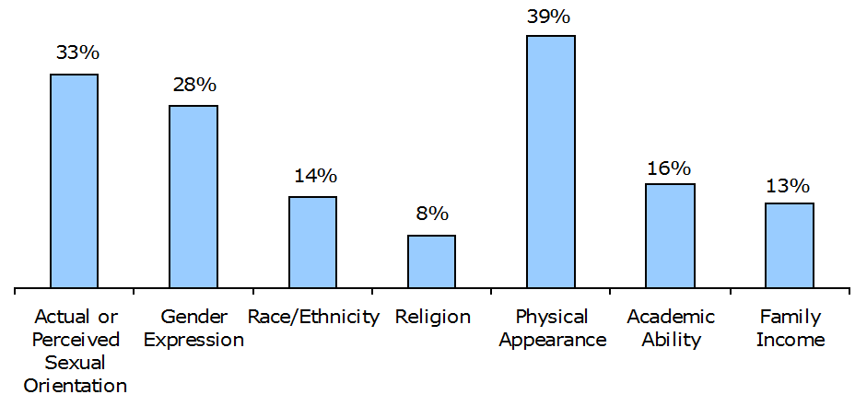

Common Reasons for Bullying and Harassment in School
Most common reasons students were bullied and harassed in school:
From Teasing to Torment: School Climate in America, A Survey of Students and Teachers 2005
Notes:
Sixth graders in a Central NJ school took a similar survey last year, “What we have heard name-calling about” and found very similar results
(with appearance at 70%, sexual orientation 64%, race 50%, and religion 20%)
The interesting thing about this study was that when parents took a survey about what name calling they thought their children heard
The parent’s response revealed bullying about sexual orientation was only 30 %.
The discrepancy was also present in the question
“What we have heard name calling about the most,”
students said 20% but no parents thought that sexual orientation was heard “most.”
10

Slide 11
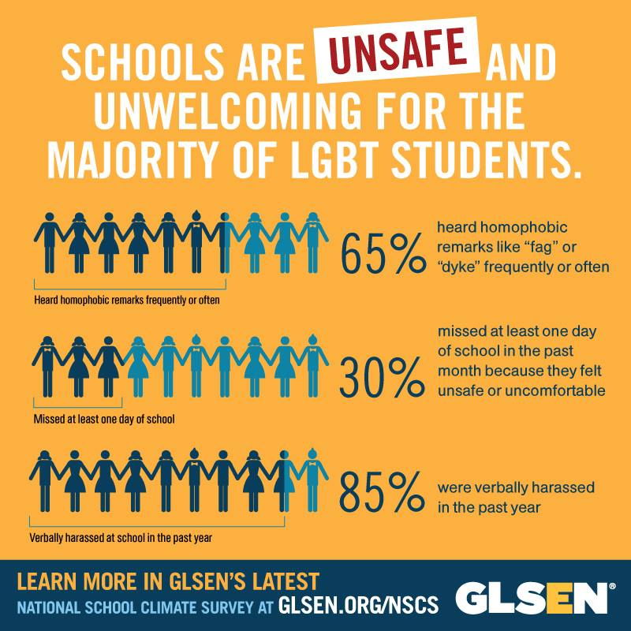

Slide 12
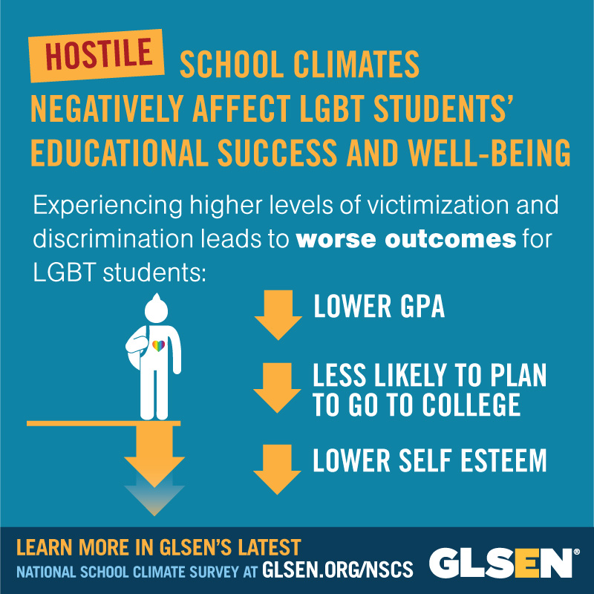

Slide 13
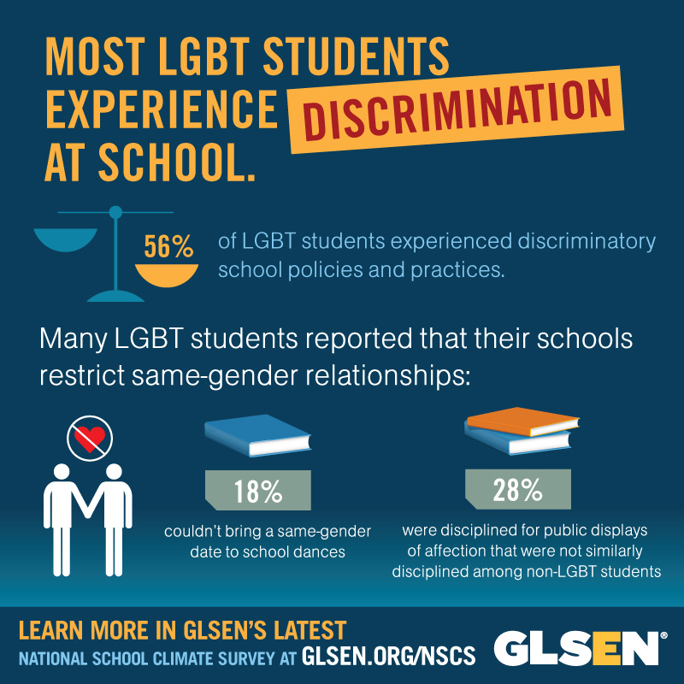

Slide 14
What are the policies and practices that can turn this experience around for LGBTQ students and signal to everyone in the school community that respect for all regardless of sexual orientation or gender identity/expression is the standard in this district?
What does the research show?
What are the best practices?

Slide 15
GLSEN recommends:
Adopt and implement a COMPREHENSIVE ANTI-BULLYING POLICY that enumerates categories such as race, gender, ethnicity, religion, sexual orientation and gender expression/identity.
REQUIRE STAFF TRAININGS to enable school staff to identify and address anti-LGBT name-calling, bullying, and harassment effectively and work toward an inclusive curriculum
Notes:
6 Steps to Speak Up handout included with resources the district received
15

Slide 16
GLSEN recommends:
SUPPORT STUDENT EFFORTS to address anti-LGBT harassment such as the establishment of a GAY STRAIGHT ALLIANCE.
INSTITUTE AGE-APPROPRIATE, INCLUSIVE CURRICULA to help students understand and respect difference within the school community and society as a whole.
Notes:
6 Steps to Speak Up handout included with resources the district received
16

Slide 17
Law and policy

Slide 18
Standing on firm legal ground
NJ Law Against Discrimination ---Unlawful to subject people to differential treatment based on race, creed, color, national origin. . .
Amended in 1992 to include sexual orientation
Amended in 2006 to include gender identity or expression

Slide 19
Anti-bullying Bill of Rights –prohibits HIB based on actual or perceived “race, color, religion, ancestry, national origin, gender, sexual orientation, gender identity and expression, or a mental, physical or sensory disability . . .”

Slide 20
The Anti-bullying Bill of Rights –has unintended consequences that may have a negative impact on LGBTQ students. For extensive recommendations to mitigate the concerns of unintended consequences, see the website www.spectrumdiversity.org.

Slide 21
Federal protections---Title IX and Dear Colleague letter of October, 2010
“Although Title IX does not prohibit discrimination based solely on sexual orientation, Title IX does protect all students, including lesbian, gay, bisexual, and transgender (LGBT) students, from sex discrimination.”

Slide 22
Concerns regarding transgender and gender nonconforming students

Slide 23

80% of transgender students felt unsafe based on their gender expression.
In comparison to LGBT students whose gender expression conformed to traditional norms, gender nonconforming students were:
more victimized
felt less safe
missed more days of school

Slide 24

Challenges Created by Policies and Activities That Segregate Students by Gender and/or Reinforce Gender Norms
Bathrooms
Locker rooms
Sports teams
Dress codes
Academic subjects
Rooming assignments
School forms/documents
Notes:
Students also reported that their schools restricted participation in courses, sports, or other school activities, according to gender. For instance, some students were told that cheerleading and dance were permitted only for girls. Others had been segregated on the basis of gender during activities like graduation.
Some students also reported that school personnel promoted gender segregation by academic subjects. Many times, the restrictions imposed a double standard on boys and girls and curtailed opportunities even for students whose gender expression could be considered more traditional.
A sizeable number of students (14.1% of those who responded to the question) also felt limited by policies and practices that sought to restrict or prescribe gender identity, gender roles, and gender expression. Students commonly mentioned gender specific dress codes, such that male students were not allowed to wear “feminine” clothing, and to a slightly lesser extent, female students were not allowed to wear “masculine” clothing. Rules about appropriate dress emerged in everyday school settings, where males were discouraged from wearing jewelry, makeup, and clothes typically worn by women, and women from wearing pants (if skirts or dresses were otherwise required). Many transgender students said that these rules often forced them to present themselves as someone they were not.
Gender-specific dress codes were also enforced at official school functions like dances, at which males could not wear dresses and females could not wear tuxedos, and graduation, at which different colored robes were specified by gender (i.e., male color and female color).
Many students also noted that, regardless of their current gender identity/expression, students whose legal sex was male (i.e., sex was male according to school documents) were ineligible for distinctions like “Homecoming/Prom Queen,” and students whose legal sex was female were ineligible to run for “Homecoming/Prom King.” These policies/practices posed obvious problems for transgender students, and also reinforced the emphasis on couples composed of one male and one female referenced above.
Gender restrictions also emerged as an issue for transgender students and students with other genders in policies/practices regarding restrooms and locker rooms and in formal recognition in class and other documents. Some students said that they were only permitted to use the bathrooms or locker rooms of their legal sex, which sometimes exposed them to danger from other students or personal discomfort. In addition, schools sometimes maintained rigid policies for sharing rooms on overnight trips or in board schools, which posed problems for transgender students.
In addition, some transgender students said that they felt discriminated against by school forms and documents that provided only binary gender options, or by the refusal of school personnel to address them by their preferred pronouns or nouns

Slide 25
Ruling of the US Department of Education Office of Civil Rights regarding the banning of a transgender student from the girls’ locker room:
“. . .OCR finds by a preponderance of evidence that the District is in violation of Title IX for excluding Student A from the benefits of its education program . . . -on the basis of sex.”
---Nov 2, 2015

Slide 26
New Jersey school grants transgender student access to boys restroom
A student was granted access to the boys bathroom after school officials previously forced him to use a unisex facility.
The student and his supportive family pressed the school to follow the NJ Law Against Discrimination with assistance from ACLU NJ.
---December, 2014

Slide 27
Resources on transgender and gender non-conforming youth concerns --At glsen.org: Webinar—Supporting Transgender and Gender Nonconforming Students
http://www.glsen.org/article/educators-support-trans-and-gnc-students
--At genderspectrum.org: Schools in Transition
https://www.genderspectrum.org/studenttransitions/

Slide 28
What’s my role?
Implementing inclusive anti-bullying policy
Being an informed staff member and helping colleagues to do the same
Supporting student efforts to foster respect
Incorporating LGBT inclusive lessons

Slide 29
“It just takes one supportive adult to make a difference.”
“Can we count on you?”

Slide 30
Thank you!

